Slide 1
Experiment 2

Slide 2
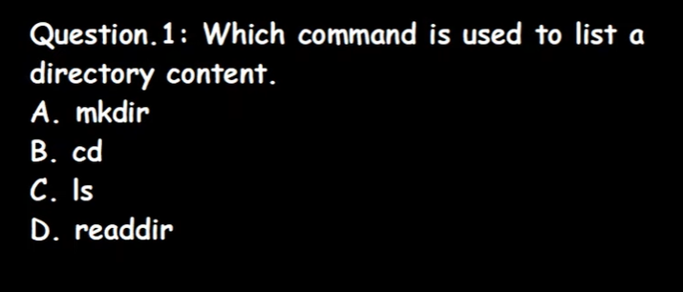
Questions:-

Slide 3
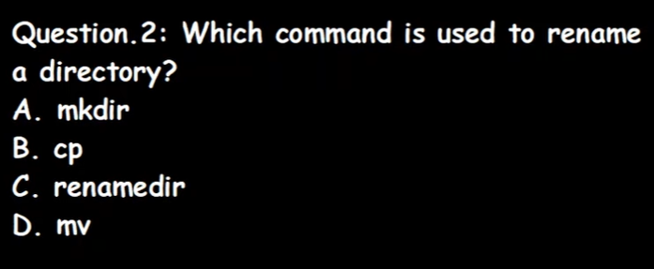
Questions:-

Slide 4
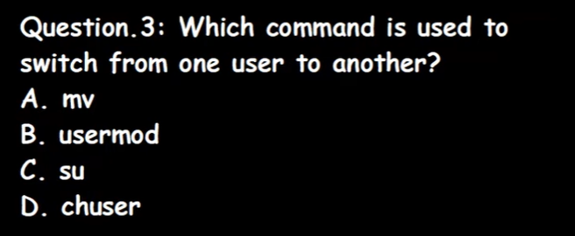
Questions:-

Slide 5
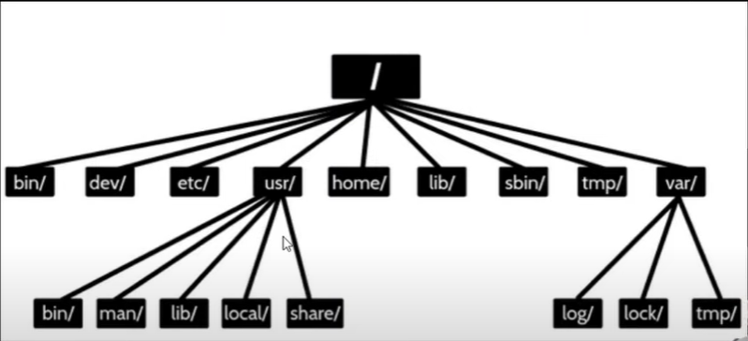
Directory Structure:-

Slide 6
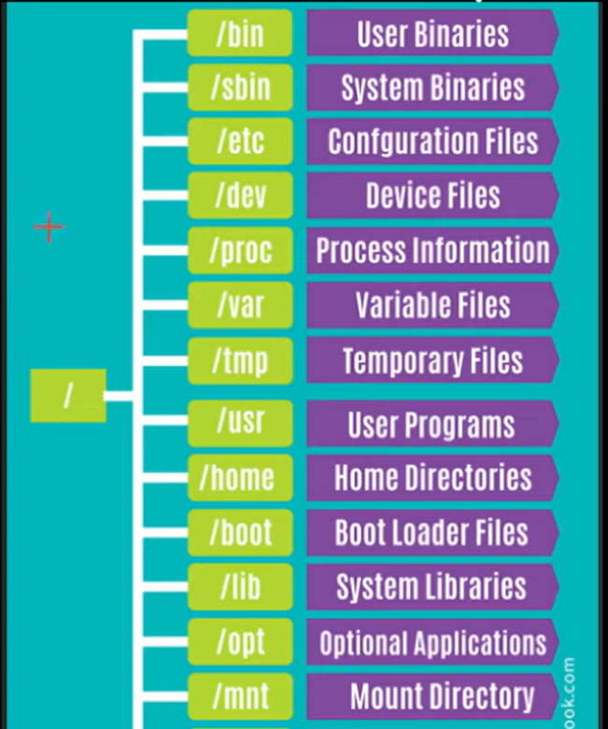
Directories Description:-

Slide 7
Check content of root directories

Slide 8
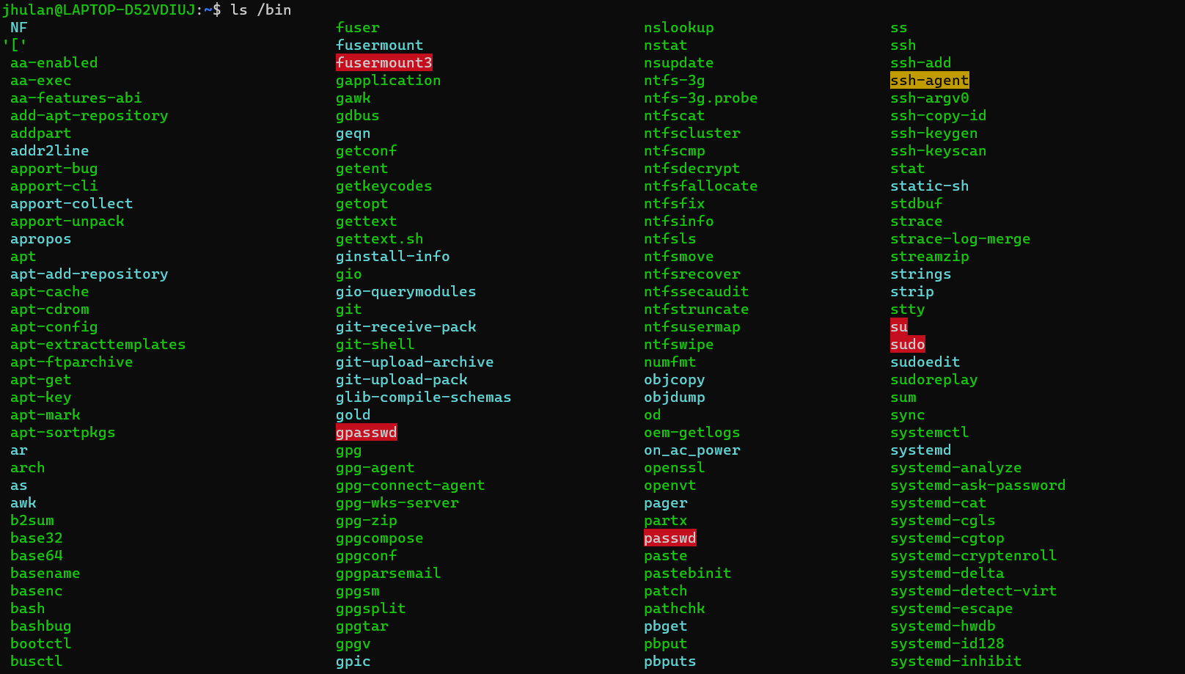
Check content of bin directories:- see available commands

Slide 9
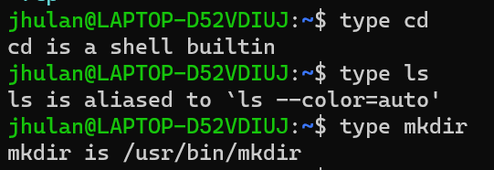
Check internal or external command:

Slide 10
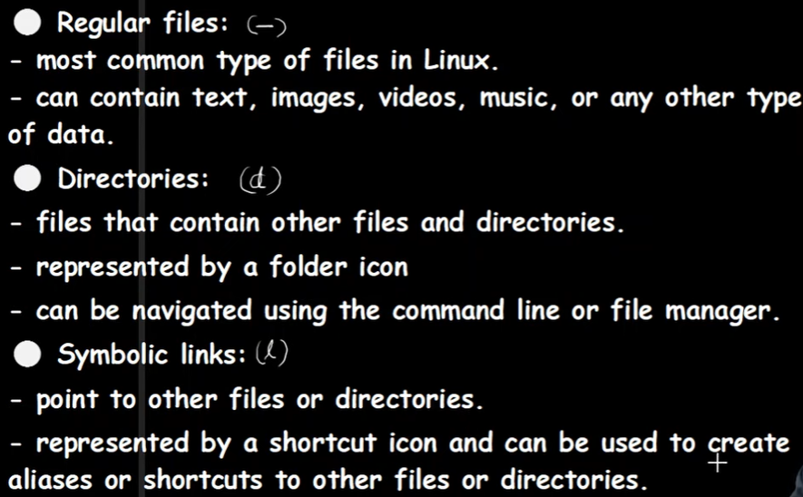

Type of files:-

Slide 11
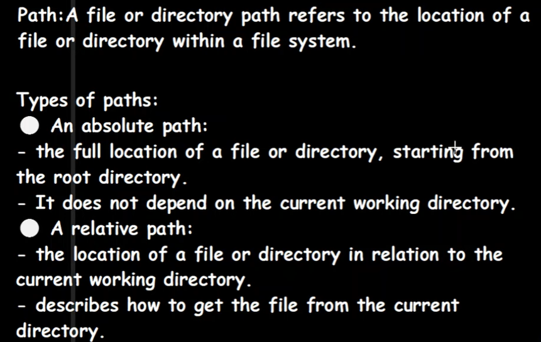
Type of file paths:-

Slide 12
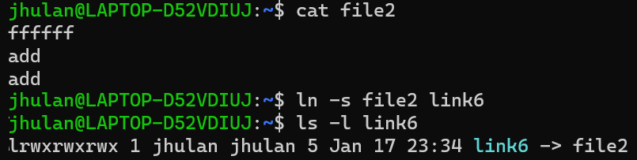
Create link of a file

Slide 13
cd ../.. (p of p)

Slide 14
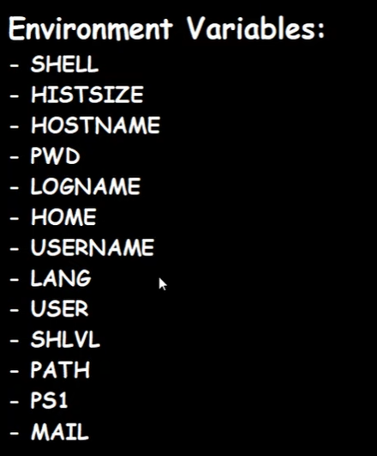
Types of variables:-

Slide 15
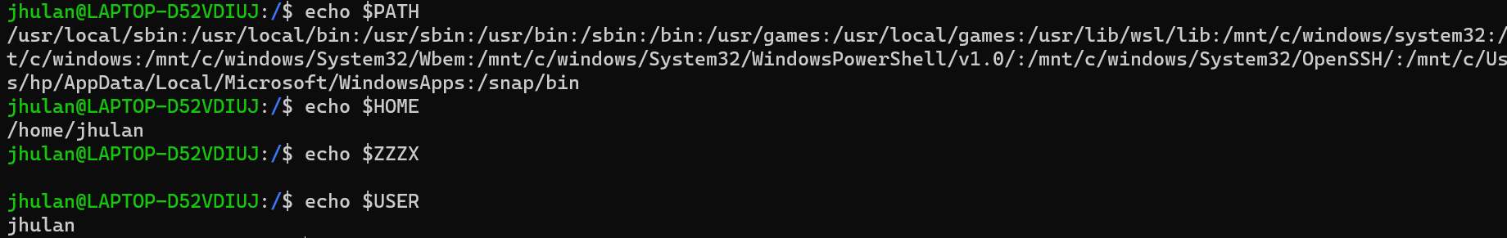
Environment Variables

Slide 16
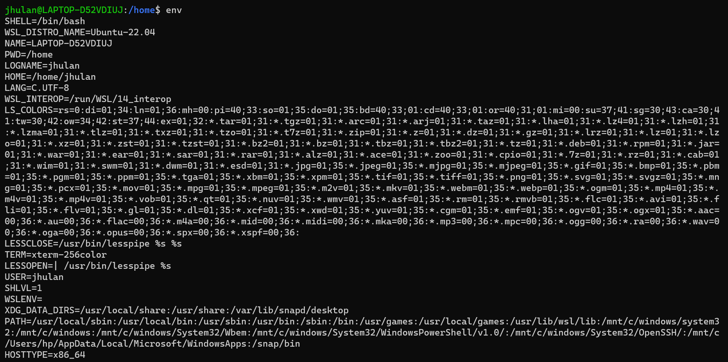
$ env to check environment variables

Slide 17
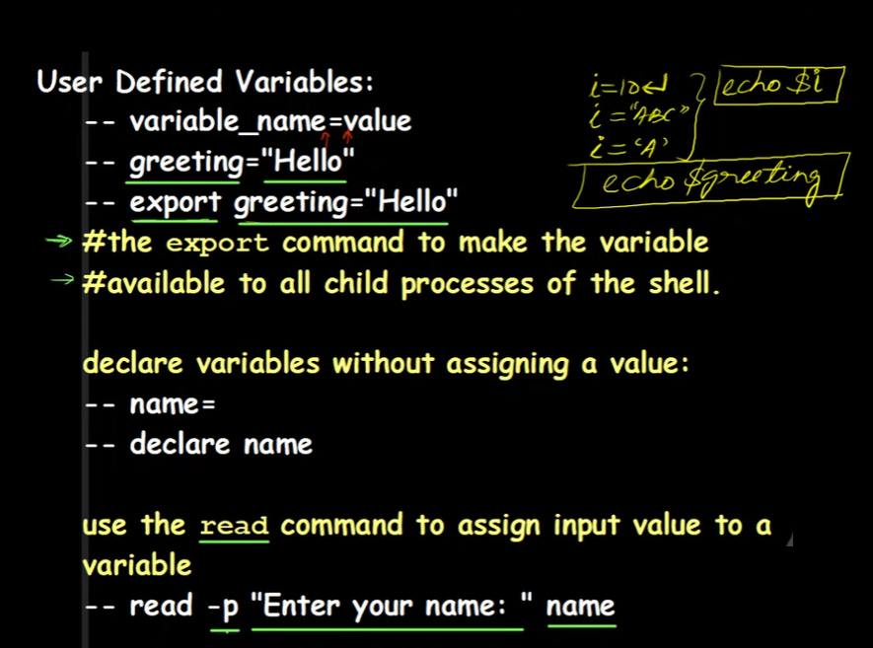
User defined variables:-

Slide 18
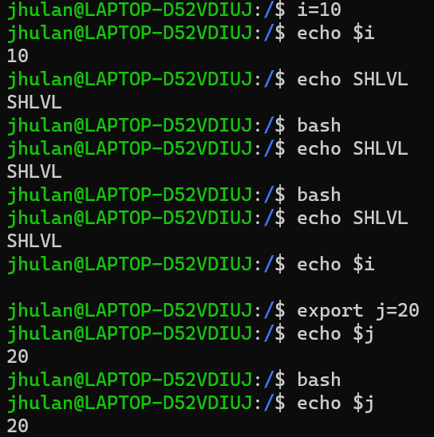
User defined variables:-

Slide 19
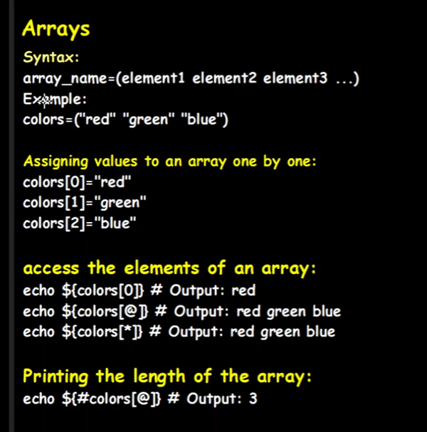

Slide 20
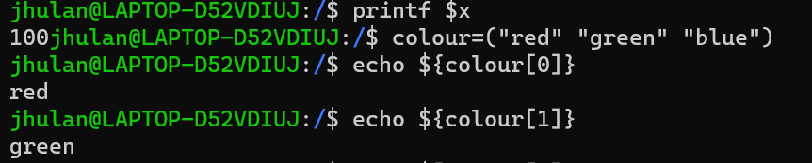
Array variables:-

Slide 21
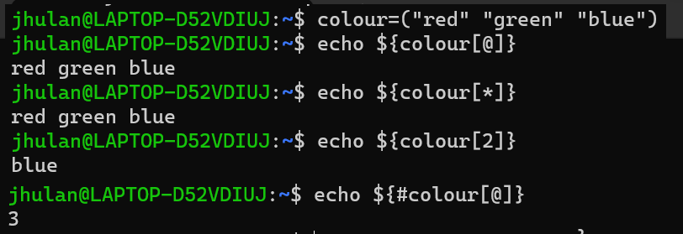
Array all elements and length of an array

Slide 22
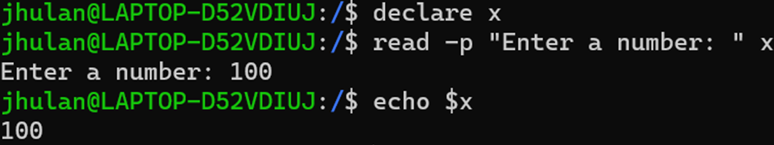
Declare a blank variable

Slide 23
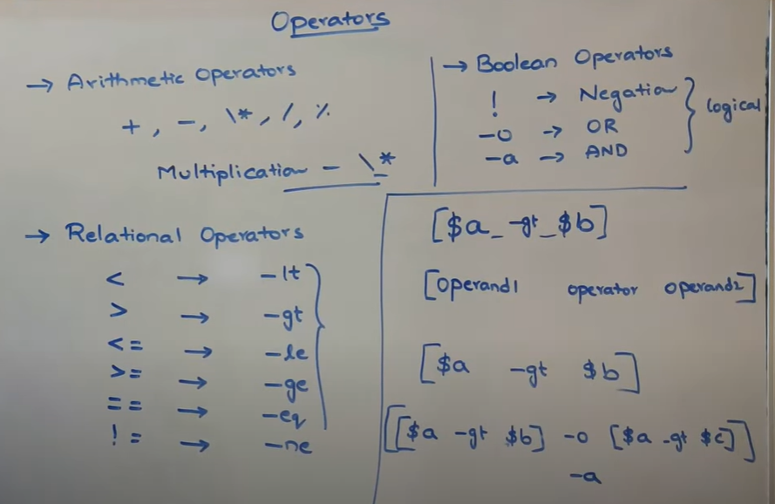
Operators

Slide 24
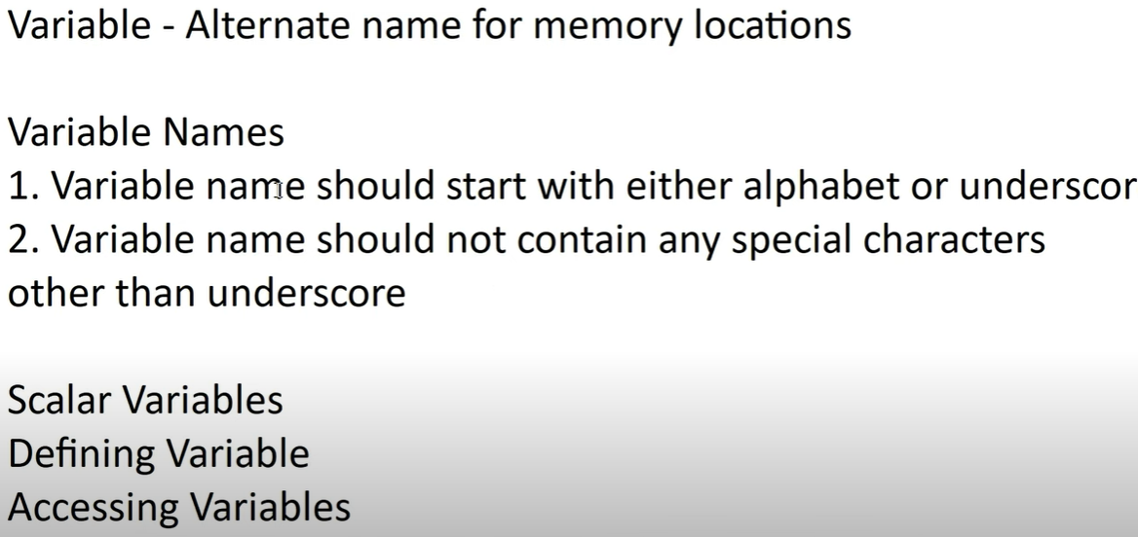

Slide 25
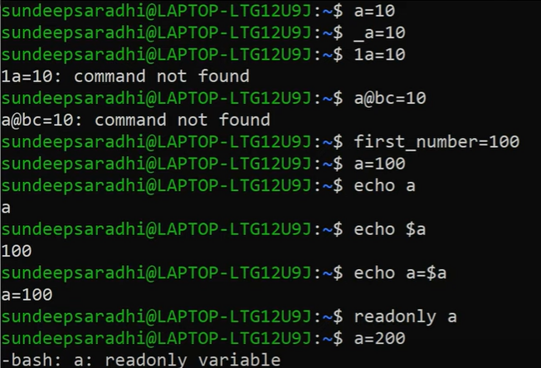

Slide 26
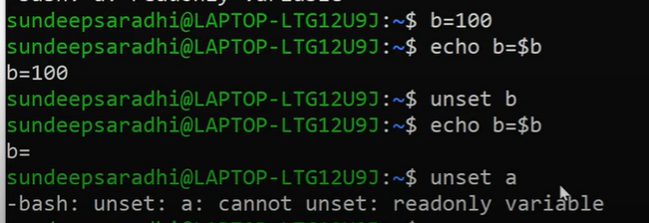
Unset a variable value:-

Slide 27
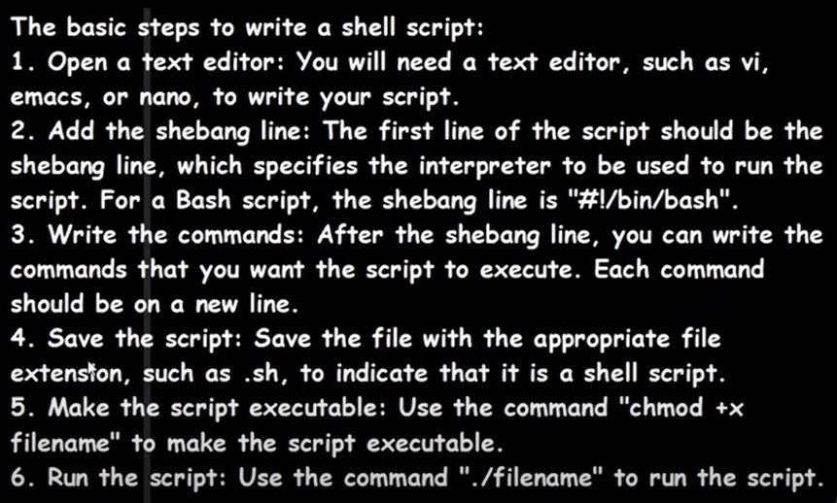
How to write a shell script:-

Slide 28
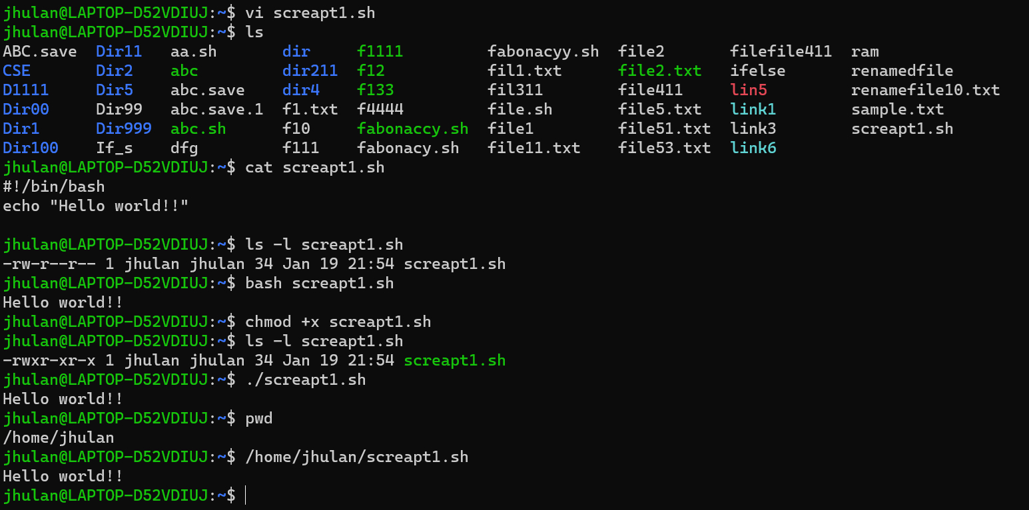
Dot (.) represent the present directory
./file_name- we can give absolute path also

Slide 29
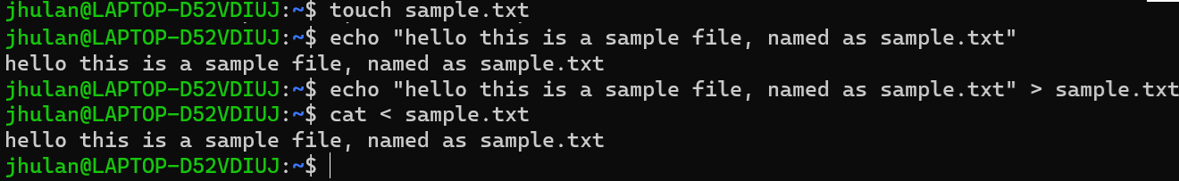
Input and output redirection:-

Slide 30
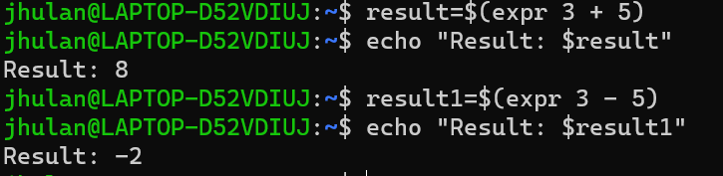
Expr commands:

Slide 31
Conditional Statements:
There are total 5 conditional statements which can be used in bash programming
if statement
if-else statement
if..elif..else..fi statement (Else If ladder)
if..then..else..if..then..fi..fi..(Nested if)
switch statement

Slide 32
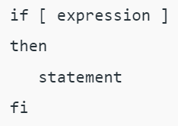
if statement
This block will process if specified condition is true.

Slide 33
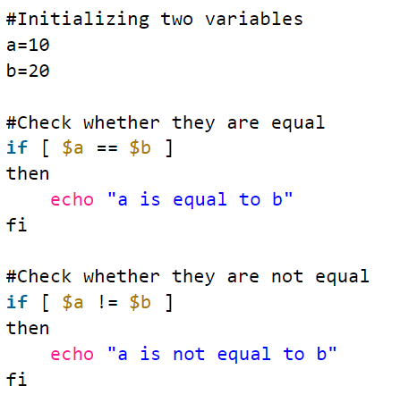
Implementing if statement :-

Slide 34
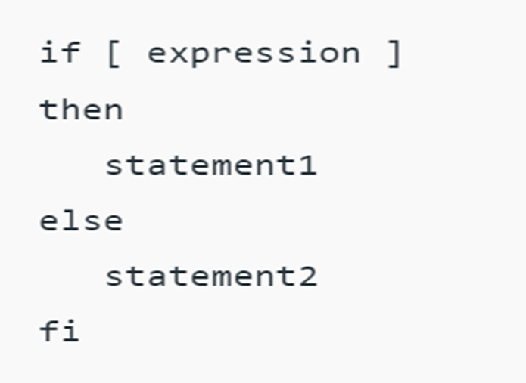
if-else statement
If specified condition is not true in if part then else part will be execute.

Slide 35
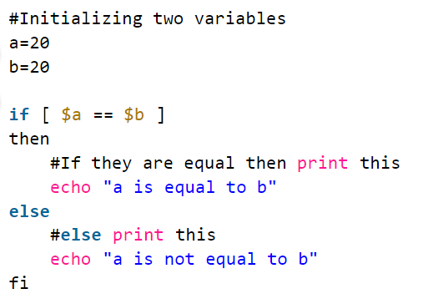
Implementing if-else statement

Slide 36
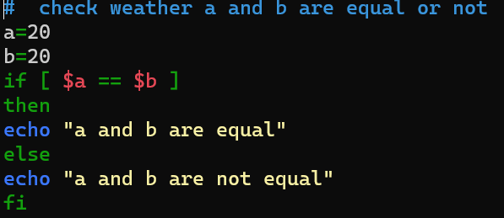
If else statement

Slide 37
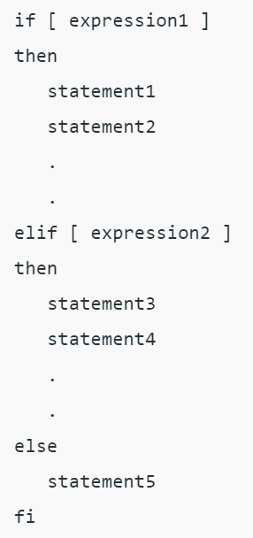
if..elif..else..fi statement (Else If ladder)
To use multiple conditions in one if-else block, then elif keyword is used in shell. If expression1 is true then it executes statement 1 and 2, and this process continues. If none of the condition is true then it processes else part.

Slide 38
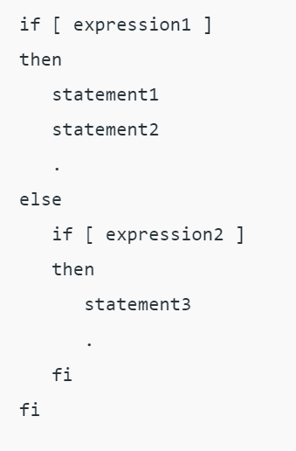
if..then..else..if..then..fi..fi..(Nested if)
Nested if-else block can be used when, one condition is satisfies then it again checks another condition. In the syntax, if expression1 is false then it processes else part, and again expression2 will be check.

Slide 39
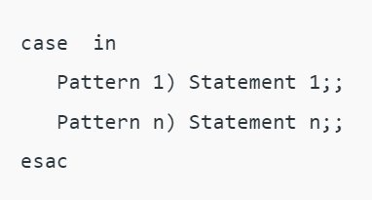
switch statement
case statement works as a switch statement if specified value match with the pattern then it will execute a block of that particular pattern

Slide 40
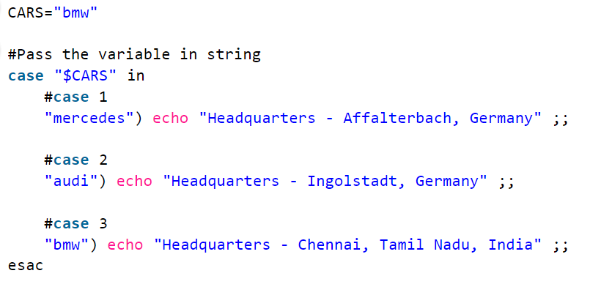
Implementing switch statement

Slide 41
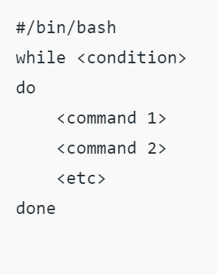
`while` statement in Shell Script in Linux
Here the command is evaluated and based on the resulting loop will execute, if the command is raised to false then the loop will be terminated that.

Slide 42
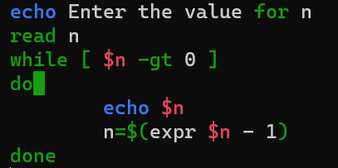
Implementation of `While` Loop in Shell Script.

Slide 43
`for` statement in Shell Script in Linux
The for loop operates on lists of items. It repeats a set of commands for every item in a list.

Slide 44
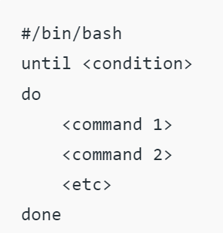
`until` statement in Shell Script in Linux
The Bash has three types of looping constructs namely for, while, and until. The Until loop is used to iterate over a block of commands until the required condition is false.
The until loop is executed as many times as the condition/command evaluates to false. The loop terminates when the condition/comm and becomes true.

Slide 45
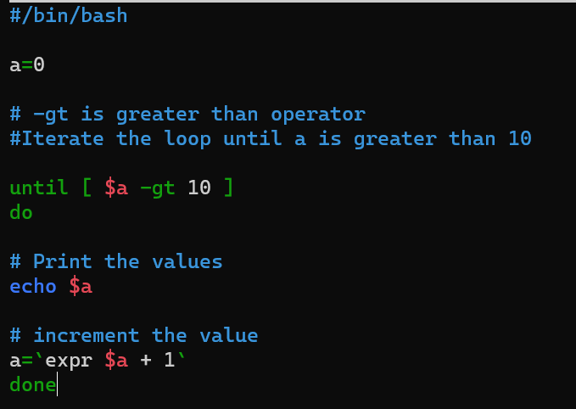
Implementation of `until` Loop in Shell Script.
Note: here symnbol before and after 1 is a “back slash comma ”. It is near the ESC key on key board.

Slide 46
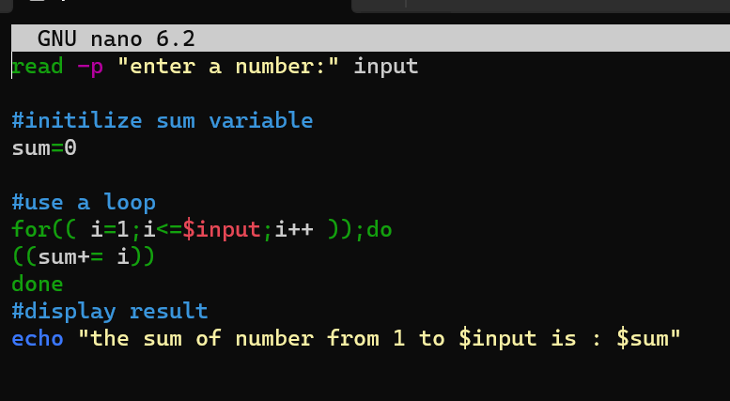
The sum of n numbers:-

Slide 47
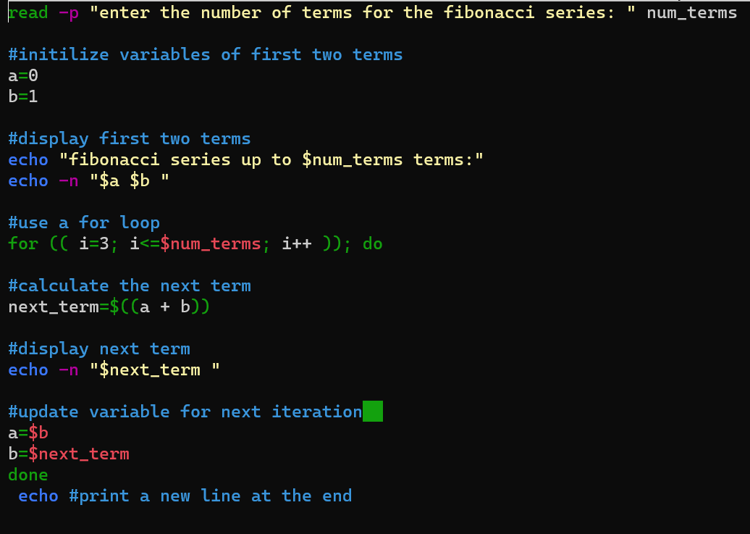
Fibonacci series

